Slide 1

Capstone Project : Football Data Analysis
Name: Ankush Chowdhury.
Mentor: (Shri) Munna Kumar Pandey.
Enrolment Number: EN12025086232
Batch Code: DA47

Slide 2

Business Objective:
Problem Statement:
Football organisations struggle to convert complex match and player data into clear, actionable strategies.
Inconsistent data quality and real-time demands make analysis challenging.
This project aims to transform raw football data into insights that drive better team performance and smarter business decisions.
Competition Analysis
Player Performance Analysis
Club Performance Analysis
Referee Analysis
Contract Management Analysis

Slide 3

Data Description
This dataset contains 54 columns and total 4654 entries (rows), few of the most important columns are grouped accordingly.
Identification Columns
appearance_id, game_id, player_id: Unique identifiers for each appearance, match, and player.
player_name_x, player_name_y: Player names (duplicated due to joins).
competition_id_x: Code for the competition (e.g., “L1” for Ligue 1, “DFB” for German Cup).
2. Match & Date Information
date_x: Date of the match.
minute: Minute when an event occurred (for substitutions, cards, etc.).
3. Performance Metrics
goals, assists: Player contributions in a match.
yellow_cards, red_cards: Disciplinary records.
shots, shots_on_target, passes, etc.
4. Event Data
Type_x: Type of event (e.g., “Cards”, “Substitutions”).
description: Text describing the event (e.g., “Yellow card – Foul”).
player_in_id: ID of the player substituted in.
game_lineups_id: Links to team lineup data.
5. Role & Position
team_captain: Indicates if the player was captain.
position_y: Player’s position (e.g., “DF”, “MF”, “FW”).
number: Shirt number.

Slide 4
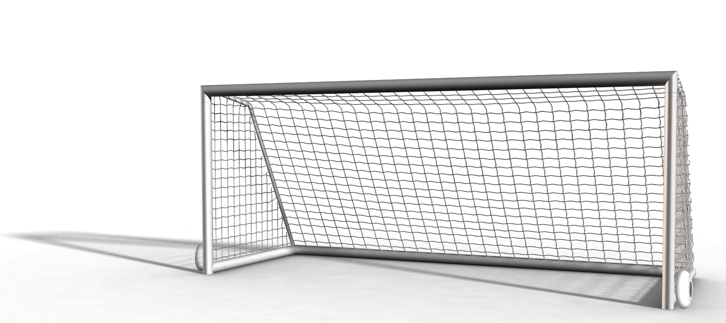
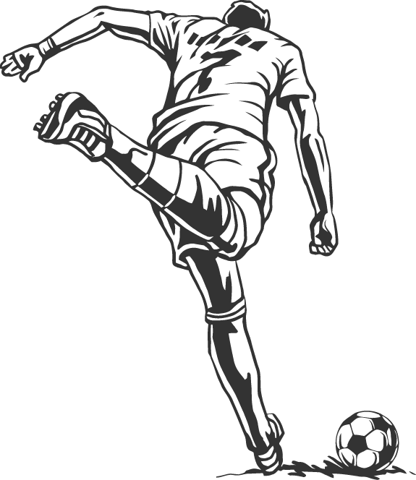
Business Objective wise Questions
Competition Analysis :
Top 20 teams in different competition in terms of home goals,
Top 20 Competitions in terms of total matches played.
Player Performance Analysis :
Top 10 goal scoring Players across all seasons,
Top 10 Players who contributed to most number of assists,
Top 10 goal scorers in Home matches and away matches simultaneously.
Demographically Player distribution.
Referee Analysis :
Referee wise total matches officiated and total cards distributed,
Competition type wise Cards Distribution,
Referee Strictness over Seasons.
Contract Management Analysis :
Players with Contract Expiration Risk (Within 6 months),
Position wise Contract duration analysis,
Market value wise Contract expiration,
Agent wise contract volume,
Contract value trend over seasons.
Club Performance Analysis :
a) Season wise performance of all clubs,
Club Stadiums with most loyal fan base,
Top 10 Clubs with most number of Home goals,
Top 10 Clubs with most number of Away goals.

Slide 5






Tools and Techniques Used
- Data Preprocessing, Data Analysis, Data loading and cleaning using pandas ( e.g., .dropna(), .groupby(), aggregation like sum(), mean() ), Handling missing values and duplicacates in dataframes, Creating new calculated columns and filtering data.
- Calculated field, Charts, Dynamic Dashboards
- Window functions ( ROW_NUMBER, PARTITION BY, OVER), Date Functions ( CURDATE, DATE_ADD, DATEDIFF, BETWEEN ), Aggregation & Grouping ( COUNT, AVG, GROUP BY ), Common Table Expressions ( WITH clause, CTEs), Ordering and Limiting ( ORDER BY, LIMIT ), Conditional Filtering ( WHERE, IS NOT NULL, IS NULL ).
- Pivot table, Sort, Calculated Field, Charts
- Frames for Dashboards.

Slide 6



1. Borussia Dortmund balances youth and experience, supporting sustained team performance. 2. Key players drive strong home and away scoring; goalkeeper contracts ensure defensive stability. 3. Top agencies shape contract negotiations; rising market values reflect increased club investment. 4. Contract expiries in 2025 need strategic focus to avoid disruption. Loyal fan base and successful youth academy enhance financial and long-term strength. 5. Referee trends affect match policy; the USA supplies diverse player talent. 6. Strong managerial leadership and data-driven planning underpin club growth and adaptation.
INSIGHTS

Slide 7
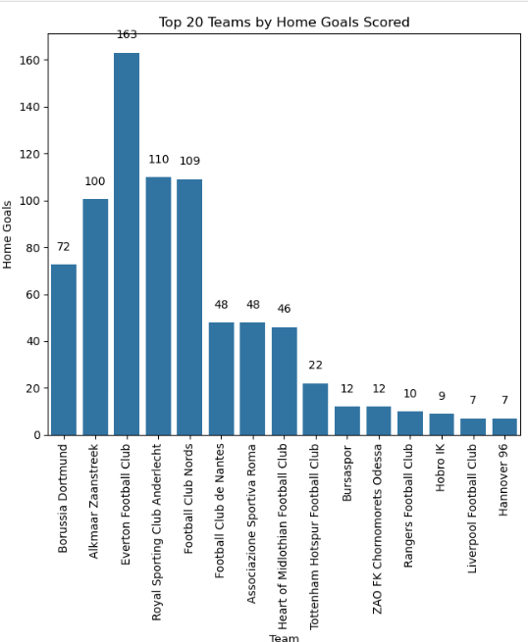
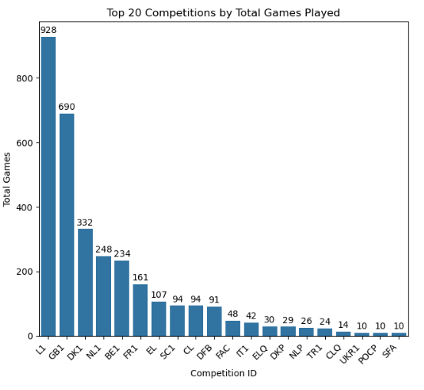
Competition Analysis
Observations:
The left chart shows that Everton FC scored the highest home goals, indicating strong home performance dominance.
The right chart reveals that competition "L1" hosted the most games, with a significantly higher total than other leagues, making it the most active competition for match play.
Q. Top 20 teams in different competitions in terms of home goals.
Methodology : Firstly calculated total home goals of Teams in each competition with group by function.
Then sorted the top 20 teams using head function.
Finally, plotted the bar chart with Seaborn.
Q. Top 20 Competitions in terms of total matches played.
Methodology : For this visual, calculated competition wise total games with group by function.
Then sorted the top 20 competitions using head function.
Finally, plotted the bar chart with Seaborn.

Slide 8
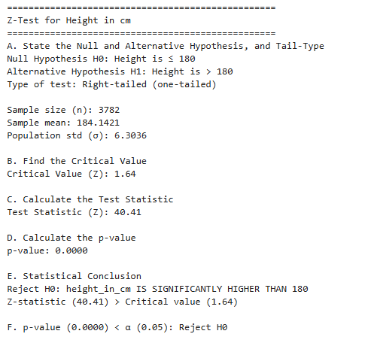
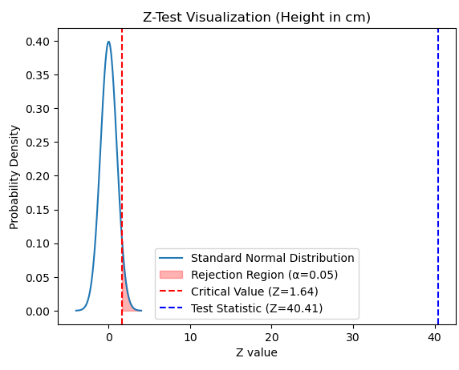
Z – Test to check if the average player height is 180 cm or lower.
Observations:
The left side presents a Z-test summary, concluding that the average height is significantly higher than 180 cm.
The right visualization reinforces this by showing the test statistic far outside the rejection region, visually confirming strong evidence against the null hypothesis.
data = df['height_in_cm'].dropna()
n = len(data) # Sample size of length.
sample_mean = data.mean()
pop_std = data.std()
mu_0 = 180
alpha = 0.05
critical_value = norm.ppf(1 - alpha)
z_stat = (sample_mean - mu_0) / (pop_std / np.sqrt(n))
p_value = 1 - norm.cdf(z_stat)
Finally with if else statement concluded the Statistics.
x = np.linspace(-4, 4, 1000)
y = norm.pdf(x, 0, 1)
plt.plot(x, y, label='Standard Normal Distribution')
plt.fill_between(x, 0, y, where=(x >= critical_value), color='red', alpha=0.3, label='Rejection Region (α=0.05)')
plt.axvline(critical_value, color='red', linestyle='--', label=f'Critical Value (Z={critical_value:.2f})’)
plt.axvline(z_statistic, color='blue', linestyle='--', label=f'Test Statistic (Z={z_statistic:.2f})’)
plt.title('Z-Test Visualization (Height in cm)’)
plt.xlabel('Z value')
plt.ylabel('Probability Density')
plt.legend()
plt.show()

Slide 9
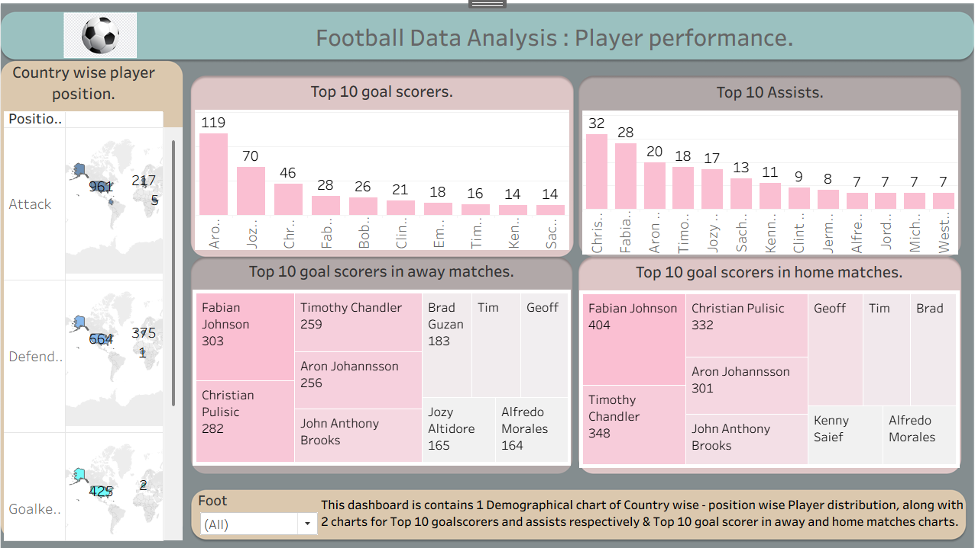
Player Performance Analysis
Observations:
Aron Johannsson leads the overall top goal scorers, standing out far above the rest in total goals.
Fabian Johnson is the highest home-match goal scorer, also tops the away-match scoring chart, showing consistent performance both home and away.
Christian Pulisic has the highest number of assists, making him the key playmaker in the dataset.
USA contributes most number of players.
Q. Top 10 goal scoring Players across all seasons.
Methodology : Dragged player names in columns and sum of goals in rows.
Added labels and filter of foot & sorted by sum of goals descending, filtered top 10.
Q. Top 10 Players who contributed to most number of assists.
Methodology : Dragged player names in columns and sum of assists in rows.
Added labels and filter of foot & sorted by sum of assists descending, filtered top 10.
Top 10 goal scorers in Home matches and away matches simultaneously.
Methodology : Used same methods as previous 2, but plotted a heatmap from SHOW ME section,
Demographically Player distribution.
Methodology : Dragged longitude in columns and Latitude and position in rows.
Added count of positions labels.
Finally, grouped all visuals in Dashboard made from FIgma.

Slide 10
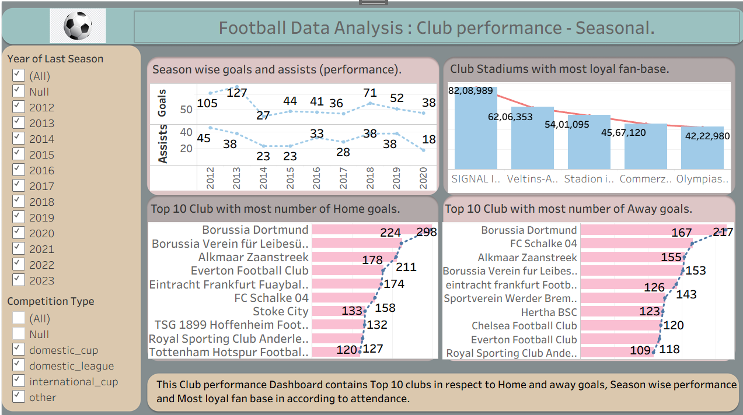
Club Performance Analysis
Observations:
Season-wise, both goals and assists peaked in 2013 and showed a general declining trend towards 2020.
SIGNAL IDUNA PARK boasts the most loyal fan-base among club stadiums, with over 82 million attendees.
Borussia Dortmund leads the top 10 clubs with the highest number of home goals, scoring 298, also tops the list for away goals, netting 217, making them dominant in both home and away matches.
Season wise performance of all clubs.
Methodology : Dragged Year in columns and sum of goals & sum of assists in rows.
Added labels and Selected line chart for proper time series analysis.
Q. Club Stadiums with most loyal fan base.
Methodology : Dragged player Stadium in columns and sum of attendance in rows 2 times, made the visual dual axis by synchronizing them.
Top 10 Clubs with most number of Home goals
Methodology : Dragged sum of home goals in rows 2 times, Club name in columns, made the visual dual axis by synchronizing them.
Top 10 Clubs with most number of Away goals.
Methodology : Used same method as previous chart.
Finally, grouped all visuals in Dashboard made from Figma, Added filters to make the Dashboard dynamic.

Slide 11
Referee Analysis
Observations:
Felix Zwayer and Dr. Ferlix Brych officiated the most matches, with Zwayer leading slightly in total cards given, indicating minor variation in referee strictness. And Bjorn Kuipers is the most strict referee amongst all.
The data reveals that referees issue 84% of their cards in domestic league matches, showing that regular season games are significantly more intense and require stricter disciplinary control compared to cup competitions where emotions might be high but actual infractions are less frequent.
Strictness trend shows a dramatic spike in both matches officiated and total cards in 2023, suggesting increased disciplinary enforcement or more games played that season.
Q. Competition type wise Cards Distribution.
Methodology : Calculated Competition wise count of total cards with pivot table.
Plotted the output.
Referee wise total matches officiated and total cards distributed.
Methodology : Calculated Referee wise count of games and total cards (made this calculated field of total cards from pivot table analyze) with pivot table.
Plotted the output.
Q. Referee Strictness over Seasons.
Methodology : Calculated Season wise sum of total cards and total number of games.
Plotted the output.

Slide 12
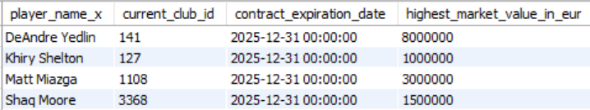
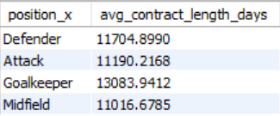
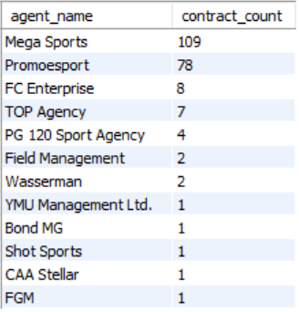
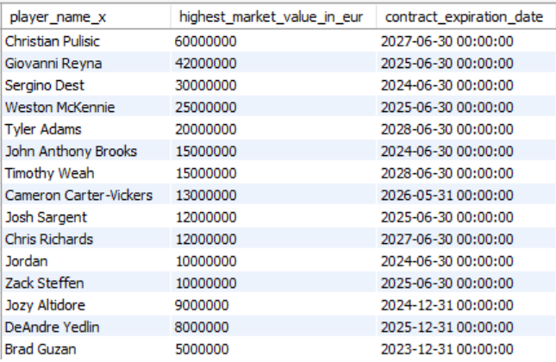
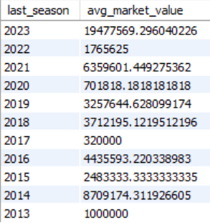
Contract Management Analysis
Observations:
The first visual highlights expiring contracts in 2025, along with market values for key players like DeAndre Yedlin and Matt Miazga.
Second visual shows that goalkeepers on average have the longest contract durations, while midfielders have the shortest among the group.
Third visual ranks player management agencies, revealing Mega Sports and Promoesport hold the largest client portfolios.
Fourth visual spotlights top players by peak market value and contract expiry, with Christian Pulisic having the highest value and latest expiry date.
Fifth visual presents average player market values by season, showing a consistent increase in player worth, with sharp rises in recent years.
Q. Players with Contract Expiration Risk (Within 6 months).
For this task used a Common Table Expression (CTE) with the WITH clause to create a temporary table named RankedContracts. It partitions players by their name and orders their contracts based on expiration dates.
Q. Position wise Contract duration analysis.
Calculated average contract duration by position using date difference grouping.
Q. Agent wise contract volume.
Written a query which counts contracts managed by each agent with contract expirations within the next year, ignores null agent names, groups data by agent, orders agents by the highest number of contracts to identify top agents.
Q. Market value wise Contract expiration.
Generated ranks of each player’s contracts by highest market value and earliest expiration using ROW_NUMBER() in a CTE, selecting only each player’s top-ranked contract for output, with ordering and a limit.
Q. Contract value trend over seasons.
Written a query which groups player records by last season, calculates the average market value for players with valid contract expiration dates, orders the results by season descending.

Slide 13
Summary
Competition analysis reveals that Everton FC stands out for exceptional home-scoring strength among top teams, indicating superior match performance at home venues. Additionally, league "L1" leads by total games played, highlighting its status as the most dynamic and active competition for club participation and operational focus.
Player performance analysis shows that Aron Johannsson is the standout top scorer and Fabian Johnson demonstrates high consistency with leading home and away goals, while Christian Pulisic excels as the top playmaker in assists. The USA provides the largest pool of players across multiple positions, highlighting strong national representation.
Club performance analysis states that Borussia Dortmund consistently ranks as a top club for both home and away goals, highlighting its attacking strength and balanced performance. Additionally, SIGNAL IDUNA PARK’s attendance confirms the club’s strong fan loyalty and substantial support base.
Referee analysis shows steady card distribution among top referees, with Felix Zwayer and Dr. Ferlix Brych officiating the most games while maintaining consistent card issuance. Strictest referee is Bjorn Kuipers. The strictness trend reveals a sharp rise in matches and cards in 2023, indicating a significant increase in disciplinary action that season.
Contract management analysis shows that key players, especially defenders and goalkeepers, have high market values and longer average contract durations, ensuring squad stability. Leading agencies like Mega Sports and Promoesport manage the most player contracts, while recent seasons reflect a steady rise in average market value. Contract management analysis reveals that key players hold valuable, long-term contracts, especially in defensive positions, promoting team stability. Major agencies dominate player management and recent seasons show rising market values, highlighting strategic negotiation importance.

Slide 14


Conclusion
Top Teams: Borussia Dortmund and Everton FC excel in both home and away performances.
Star Players: Aron Johannsson, Fabian Johnson, and Christian Pulisic lead in scoring and assists.
Contract Stability: Clubs retain key players through long-term, high-value contracts managed by top agencies.
Market Growth: Rising player market values reflect increasing financial and sporting strength.
Referee Insights: Recent seasons show higher match strictness, calling for improved team discipline.
Z-Test Insight: Players’ average height is significantly above 180 cm, confirming strong physical standards.
Strategic Value: These insights support better planning, talent retention, and data-driven football management.

Slide 15


Business Suggestion
Clubs should leverage data-driven insights for player recruitment and match strategies to sustain competitive advantage.
Proactively manage contracts for key players, focusing on early renewals and aligning contract lengths with performance metrics.
Invest in player development by strengthening youth academies and providing pathways for domestic talent.
Enhance fan engagement through innovative stadium experiences and targeted marketing to maintain strong support bases.
Align cross-functional teams—coaching, analytics, and business operations—under a unified strategic vision for operational excellence.
Monitor referee and competition trends to adapt training and discipline, reducing match penalties and optimizing team performance.

Slide 16
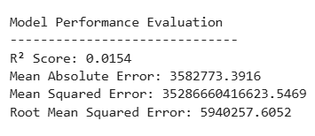
Business Implementation of ML model.
Question :
Predict the market value of players with respect to Goals, Assists & minutes played.
features = ['goals', 'assists', 'minutes_played’]
target = 'market_value_in_eur’
X = df_clean[features]
y = df_clean[target]
X_train, X_test, y_train, y_test = train_test_split(X, y, test_size=0.2, random_state=42)
scaler = StandardScaler()
X_train_scaled = scaler.fit_transform(X_train)
X_test_scaled = scaler.transform(X_test)
model = LinearRegression()model.fit(X_train_scaled, y_train)
r2 = r2_score(y_test, y_pred)
mae = mean_absolute_error(y_test, y_pred)
mse = mean_squared_error(y_test, y_pred)
rmse = np.sqrt(mse)
Model Evaluation :
Multiple Linear Regression : The poor R² score indicates that the selected features (goals, assists, minutes played) do not sufficiently explain the variability in market value. The model lacks predictive power with these inputs alone. The presence of high MAE and RMSE further emphasizes that the predictions deviate considerably from actual values, indicating the model is likely underfitting the data.

Slide 17
Limitation and Future Scope
Limitations
Data availability and quality is limited by inconsistencies, missing values, or lack of access to confidential contract details and real-time performance metrics.
External factors such as injuries, sudden transfers, and unpredictable referee decisions are not fully captured, which may affect the accuracy of performance and contract predictions.
The complexity of football dynamics, including off-field influences, coaching decisions, and psychological factors, are difficult to quantify and integrate into purely data-driven analyses.
Future Scopes
Integrate multi-source real-time data including player biometrics, injury reports, and detailed match event tracking for enhanced predictive modeling.
Develop user-friendly, modular analytics platforms that bridge the gap between technical data insights and practical coaching or management applications.
Expand analytics coverage to grassroots and youth levels while incorporating qualitative inputs to improve holistic player assessment and decision-making.

Slide 18

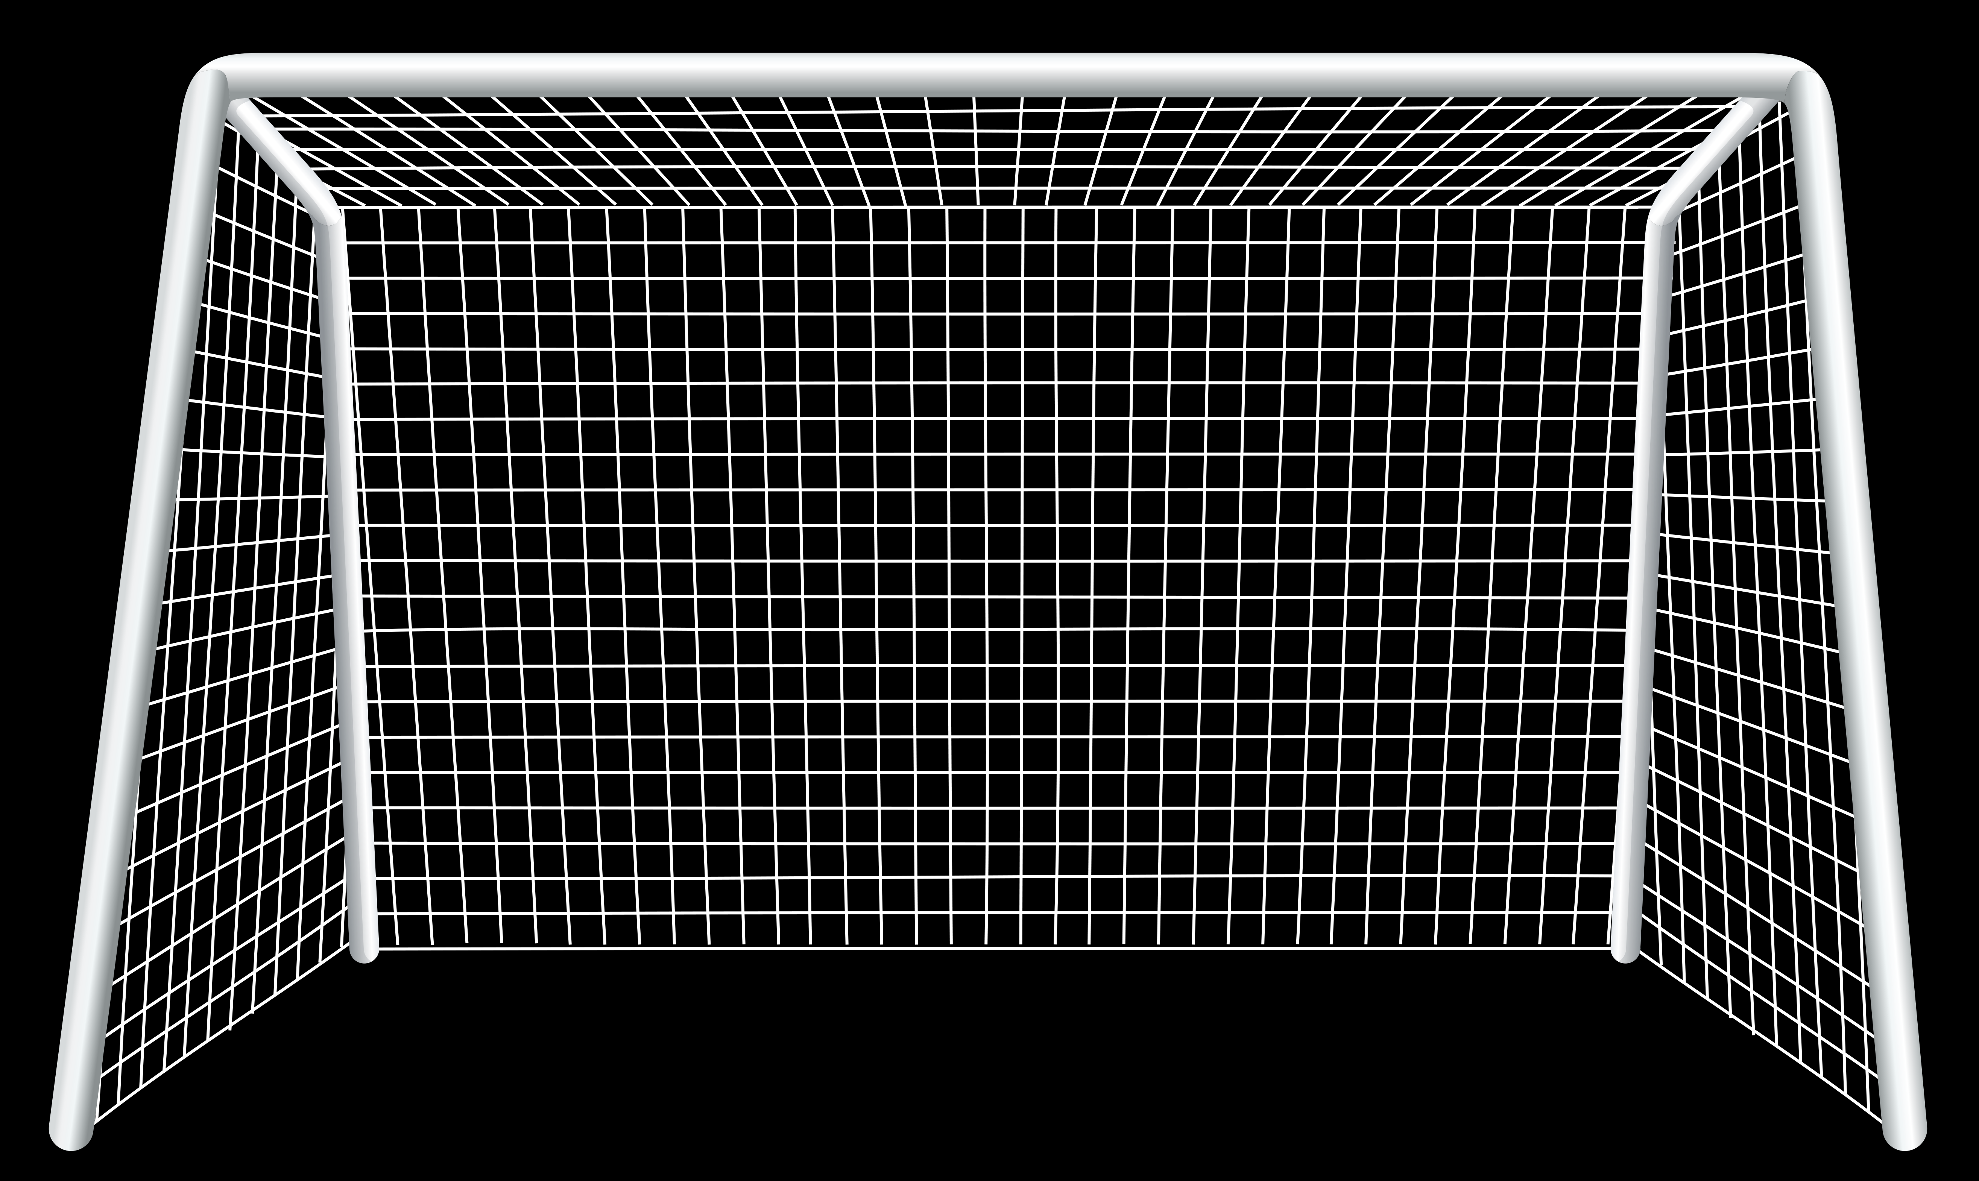


THANK YOU!

